Slide 1
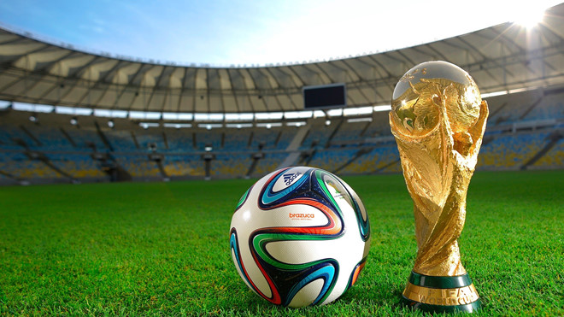

Slide 2
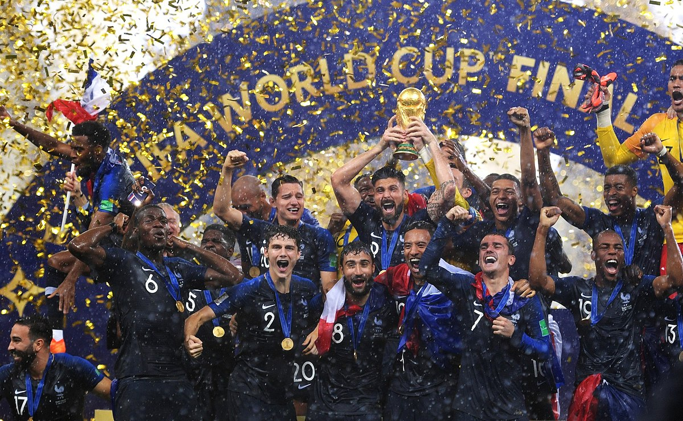

Slide 3
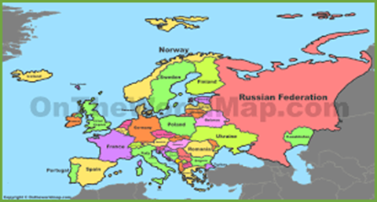

Slide 4
THE FINAL MATCH

Slide 5
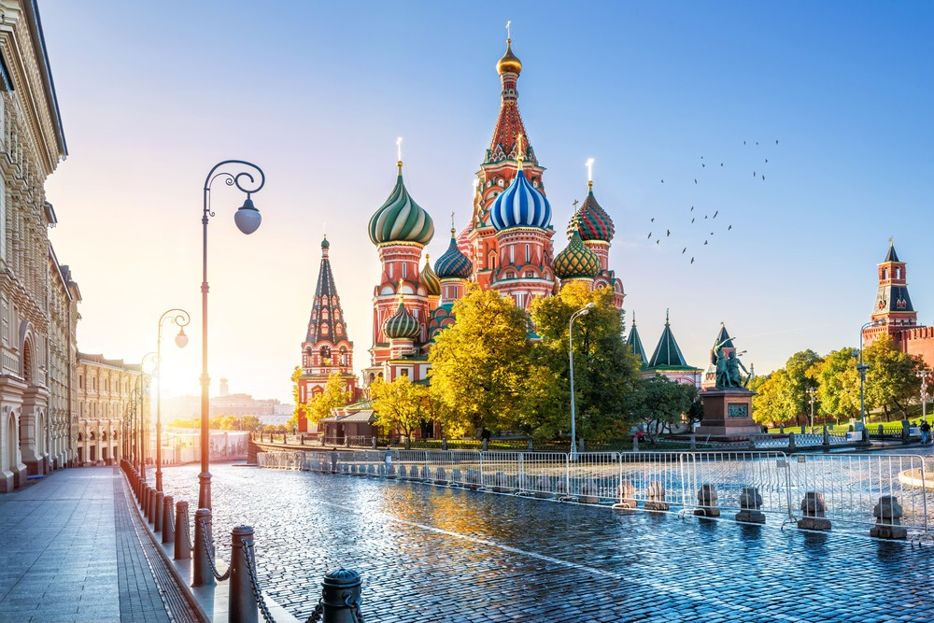

Slide 8
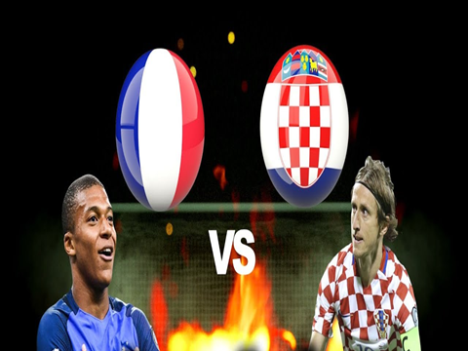
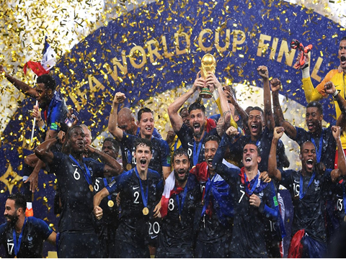
The 21st World Cup

Slide 9
UNIT 14: THE WORLD CUP
B. SPEAKING

Slide 10
UNIT 14: THE WORLD CUP
B. SPEAKING
Task 1:
Conversation 1 | Conversation 2
A: Where and when was the first World Cup held? B: It was held in Uruguay in 1930 A: Which teams played in the final match? B: Uruguay and Argentina A: Which team became the champion? B: Uruguay A: What was the score of the match? B: 4-2 | A: Where and when was the twenty-first World Cup held? B: It was held in Russia in 2018 A: Which teams played in the final match? B: France and Croatia A: Which team became the champion? B: France A: What was the score of the match? B: 4-2

Slide 11
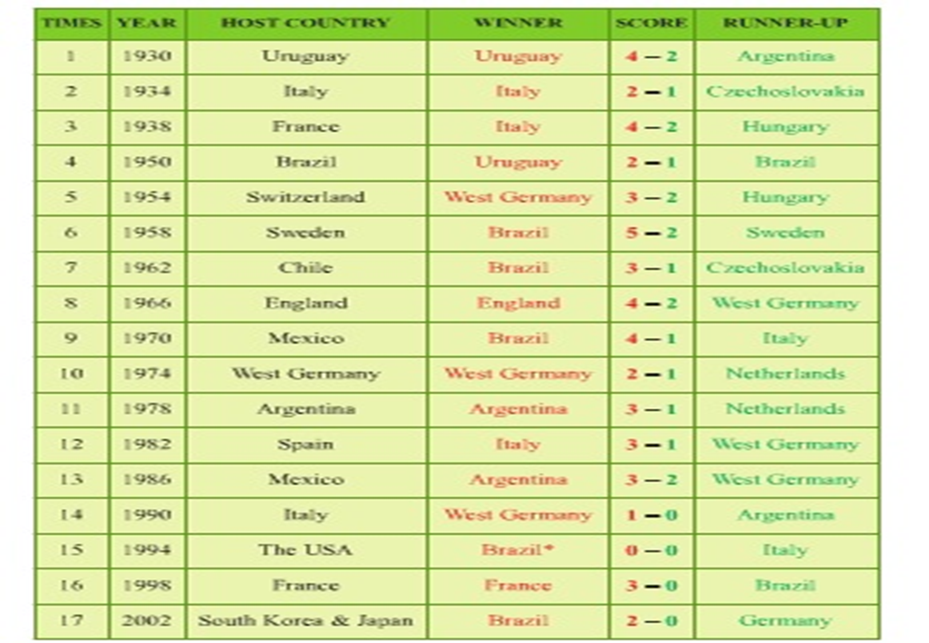
UNIT 14: THE WORLD CUP
B. SPEAKING
Task 1:

Slide 12
UNIT 14: THE WORLD CUP
B. SPEAKING
Task 2:
A: Where and when was the first World Cup held?
B: It was held in Uruguay in 1930
A: Which teams played in the final match?
B: Uruguay and Argentina
A: Which team became the champion?
B: Uruguay
A: What was the score of the match?
B: 4-2
times
Host country
Year
Winner
Runner-up
Winner
Score

Slide 13
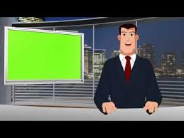
UNIT 14: THE WORLD CUP
B. SPEAKING
Task 3:
The first World Cup was held in Uruguay in 1930. The final match was between Uruguay and Argentina. Uruguay defeated Argentina by 4-2 to win the trophy.
Times | Year | Host country | Winner | Score | Runner-up
1 | 1930 | Uruguay | Uruguay | 4 - 2 | Argentina

Slide 14
UNIT 14: THE WORLD CUP
B. SPEAKING
Task 3:
The twenty-first World Cup took place in Russia in 2018. The two teams playing in the final match were France and Croatia. The score of the match was 4-2. Croatia lost the match to France by two points. The trophy was awarded to France and Croatia became the runner-up.
Times | Year | Host country | Winner | Score | Runner-up
21 | 2018 | Russia | France | 4 - 2 | Croatia

Slide 15
UNIT 14: THE WORLD CUP
B. SPEAKING
Times | Years | Host country | Winner | Score | Runner-up
18 | 2006 | Germany | Italy | 5-3 (Penalty shoot-out) | France
19 | 2010 | South Africa | Spain | 1-0 | Netherlands
20 | 2014 | Brazil | Germany | 1-0 | Argentina

Slide 16
UNIT 14: THE WORLD CUP
B. SPEAKING
Homework
Write a paragraph about
your favourite World Cup tournament

