Slide 1
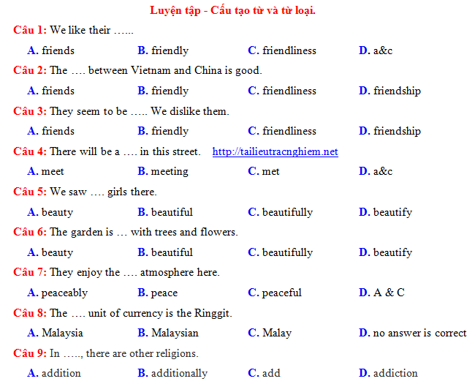

Slide 2
Word
1 | beatify | beautiful | beauty | beautifully
2 | modernize | modern | modernization | modernly
3 | amaze | amazing | amazement | amazingly
4 | affect | effective | effect | effectively
5 | care | careful | carefulness | carefully
6 | differ | different | difference | differently
7 | educate | educational | education | educationally
8 | succeed | successful | success | successfully
Verb
Adjective
Noun
Adverb

Slide 3
SUBJECT:
THE RECOGNITION
OF PART OF SPEECH BASED ON POSITION IN SENTENCES

Slide 4
SUBJECT:
THE RECOGNITION OF PART OF SPEECH BASED ON POSITION IN SENTENCES
I. Verbs
Ex1: The farmer modernized his grinder himself.
→ after subject
Ex2: Work hard if you want to succeed
Ex3: This key seems to differ from the one I have seen.
→ structure in which it becomes “to V_{inf}”
Ex4: Parents are responsible for educating their children.
Ex5: I’m a nurse. I don’t mind caring for the sick.
→ structure in which it becomes “V_{ing}”
Ex6: Don’t let it affect you.
Ex7: We watched little Kate beautify her cat.
→ structure in which it becomes bare “V_{inf}”

Slide 5
SUBJECT:
THE RECOGNITION OF PART OF SPEECH BASED ON POSITION IN SENTENCES
II. Adjective
Ex1: She’s wearing a different dress every time I see her.
→ before a noun
Ex2: The furniture of this house is modern.
Ex3: The hill becomes extremely beautiful at sunset.
→ after linking verbs (be, look, seem, feel, become, taste, sound,…)
→ after an adverb
Ex4: He is too careless to take on this job.
Ex5: She looked so different that I couldn’t recognise her.
→ structure with “linking verb + too…to V_{inf}”
→ structure with “linking verb + so…that….”
Ex6: Your measure is more effective than that of mine.
→ forms of comparison (with linking verbs)

Slide 6
SUBJECT:
THE RECOGNITION OF PART OF SPEECH BASED ON POSITION IN SENTENCES
III. Noun.
Ex1: Beauty is what every woman desires.
→ Subject of a sentence
Ex2: He worked really hard in order to achieve success and fame.
→ Object of a sentence / a verb
Ex3:Marie Curie received general education at local school.
→ after an adjective
Ex4: Her carefulness helps her get good results in every exam.
→ after a possessive adjective (my, your, our, their, his, her, its)
Ex5: We were all filled with amazement.
→ after a preposition (with, of, about, of, for…)
Ex6:The effect of his mistake was serious.
→ after an article (a, an, the)

Slide 7
SUBJECT:
THE RECOGNITION OF PART OF SPEECH BASED ON POSITION IN SENTENCES
IV. Adverb.
Ex1: Educationally, this product is unacceptable.
→ at the beginning of the sentence, before subject.
Ex2: Matt has successfully won that contract for his company.
→ between auxiliary and verb (before verb)
Ex3: The accident wouldn’t happen if he drove carefully.
→after a verb / at the end of the sentence
Ex4: This temple is amazingly high.
→ before an adjective
Ex5: She wrote the essay so carefully that it took her weeks to finish it.
→ in structure with “ordinary verb + so…that…”
Ex6: You work more effectively than me.
→ in forms of comparison (with ordinary verbs)

Slide 8
SUBJECT:
THE RECOGNITION OF PART OF SPEECH BASED ON POSITION IN SENTENCES
Noun | Adjective | Adverb | Verb
Subject | before noun | before subject. | after subject
Object | after linking verbs | between auxiliary and verb | in certain structures
after adjective | after an adverb | after a verb
after possessive adjective | linking verb + too…to V_{inf} linking verb + so…that…. | before an adjective
after preposition | comparison (with linking verbs) | ordinary verb so…that…
after article |  | comparison (with ordinary verbs)

Slide 9
SUBJECT:
THE RECOGNITION OF PART OF SPEECH BASED ON POSITION IN SENTENCES
Practice 1: Choose the best answer for each of the following question.
1. Miss Hoa is very_____. She goes to church every morning.
A. religious B. religiously C. religion D. region
2. Some designers have_____ the Aodai by printing lines of poetry on it.
A. modernized B. modernize C. modern D. modernly
3. The restaurant has excellent _____ for serving some of the finest food.
A. repute B. reputed C. reputation D. reputable
4. If we go to the Brisbane Institute of English in Australia, we can practice speaking English with ______ speakers.
A. nation B. national C. native D. natively
5. We’ll make this beach clean and _____ again.
A. beauty B. beautiful C. beautifully D. beautify
A
A
C
C
B

Slide 10
SUBJECT:
THE RECOGNITION OF PART OF SPEECH BASED ON POSITION IN SENTENCES
Practice 1: Choose the best answer for each of the following question.
6. Nobody hates you! It’s all in your _______.
A. imagine B. imaginary C. imagining D. imagination
7. Students say it is helpful if teachers _______ their pronunciation.
A. correct B. correction C. corrective D. correctly
8. Many locals are ____ opposed to the development.
A. strength B. strong C. strengthen D. strongly
9. A large number of inhabitants have made __________ on how to protect the environment.
A. suggest B. to suggest C. suggestion D. suggested
10. The ____ of the strike caused a lot of poverty.
A. continue B. continuous C. continuation D. continual
D
A
D
C
C

Slide 11
SUBJECT:
THE RECOGNITION OF PART OF SPEECH BASED ON POSITION IN SENTENCES
Practice 1: Choose the best answer for each of the following question.
11. She has a highly _______ mind.
A. invent B. inventive C. inventor D. invention
12. Miss White sang very__________ at my birthday party last night.
A. beautifully B. beautify C. beauty D. beautiful
13. You need to be more _______.
A. decide B. decision C. decisive D. decided
14. _______, we’ll arrive before dark.
A. Hope B. Hopeful C. Hopefully D. Hopefulness
15. Everyone must take part in ______ deforestation.
A. preventing B. preventive C. preventable D. prevention
B
A
C
C
A

Slide 12
SUBJECT:
THE RECOGNITION OF PART OF SPEECH BASED ON POSITION IN SENTENCES
Practice 2: Supply the correct form of the word in bracket.
1. We started our trip on a beautiful…………...morning. (SUN)
2. It was one of the most important ………..………. of the century. (ACHIEVE)
3. Driving too fast is a ………….……. thing. (DANGER)
4. The new supermarket is designed ………………………. (ATTRACT)
5. Wealth had not brought them ………………………. (HAPPY)
6. She takes the ………………….. for running the household. (RESPONSIBLE)
7. Although they are twins, they have almost the same appearance but they seldom …………..…with each other. (AGREEMENT)
8. I’m completely………………..with the poor results of your work. (SATISFY)
9. …………..………beautiful, Hue, the former capital of Vietnam, is steeped in history (BREATH)
10. The knife may need.......................before it is used. (SHARP)
sunny
achievements
dangerous
attractively
happiness
responsibility
agree
dis
sastisfied
Breathtakingly
sharpening

Slide 13
THANKS
FOR YOUR LISTENING

